Slide 1

The Ticket Price Modeling of the Big Mountain Resort

Slide 2
The Background and Question
The Big Mountain Resort is a ski resort in Montana, Every year about 350,000 people ski or snowboard at Big Mountain. These are serviced by 11 lifts, 2 T-bars, and 1 magic carpet for novice skiers.
Recently the Resort installed a new chair lift to increase the distribution of customers, it increased the operating cost by $1,540,000 this season.
The question is:
1. Is the investment worthwhile?
2. Is the ticket of the Big Mountain resort priced well to maximize the return?

Slide 3
Recommendation Based on the Modeling
The predicted price of Big Mountain Resort is $95.9 ±10, compared with the current price of $81, there is still some room for the price increase.
The installation of a new chair lift can support a price increase of $0.29 and a yearly revenue increase of $520,000. It may not be worth the investment.
The closing of 10 runs can decrease the predicted price of $1.75, which may cause a yearly revenue loss of $3,000,000.

Slide 4
How we made the prediction?
We collected data from 276 ski resorts from United States and compare data and ticket prices.
Besides the ski resort data, we also used the related state data such as total area, population and resort numbers. These numbers were converted to ratio data such as resorts per state, state total ski area and so on for the comparisons.
Totally 32 numeric features were used for the comparisons. We found the features important for the price were vertical drop, Snow making area, total chair lifts, fast quads, runs, longest run, trams and skiable terrain area.

Slide 5
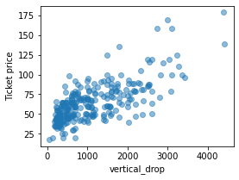
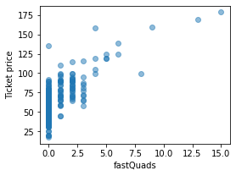
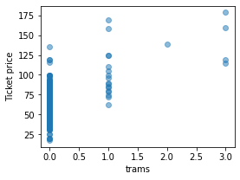
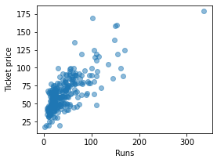
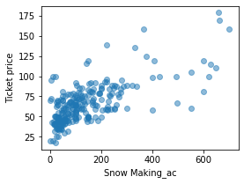
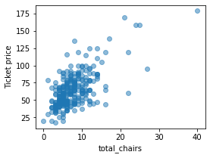
The Relationship between Price and Features

Slide 6
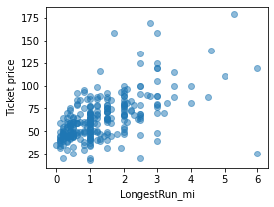
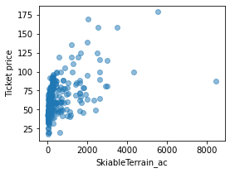
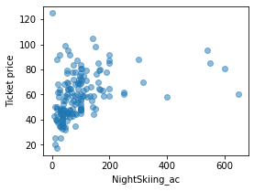
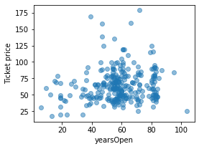
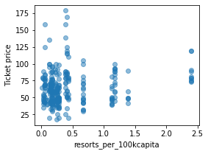
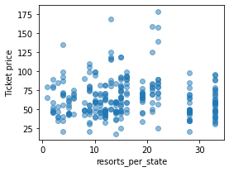
The Relationship between Price and Features-2

Slide 7
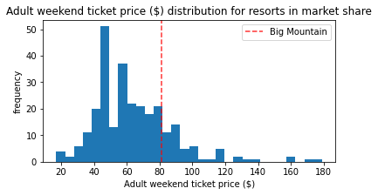
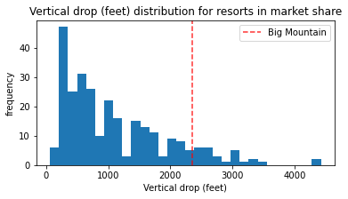
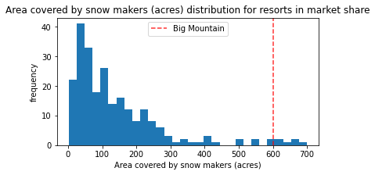
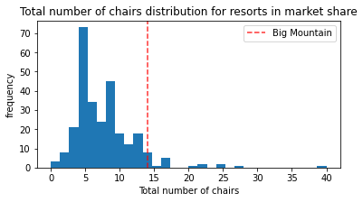
Where is Big Mountain Resort?

Slide 8
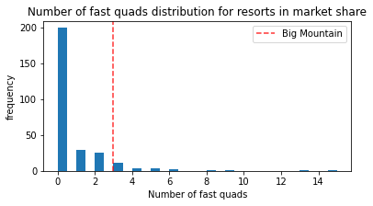
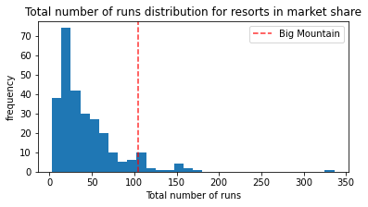
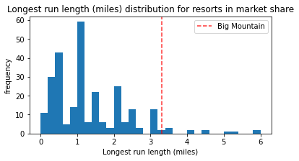
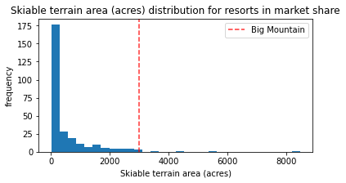
For most of the important features for deciding price, Big Mountain has one of the highest number

Slide 9
Summary
1. By using the Random Forest Model , we predicted the price of Big Mountain can be $95.9, so there is still room for some price increase from current price of $81. The predicted high price of the big mountain resort is due to its high number of the price deciding features.
2. The model can also be used for predicting the cost and return of the investments.
3. Further improvement of the prediction model is possible with new data input such as the visitor number of every resort.

